Slide 1
The Dorsal and Ventral Body Cavities
(& Subcompartments)

Slide 2
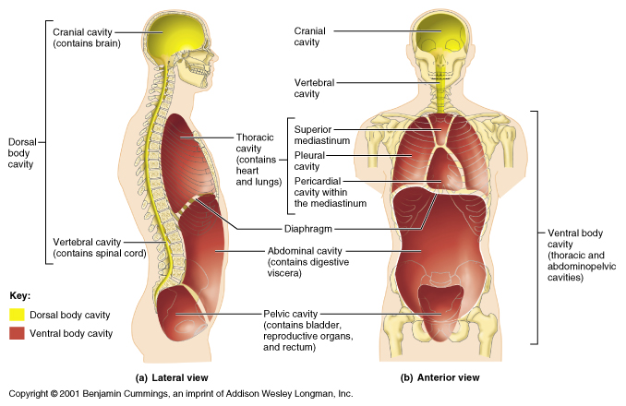

Slide 3
The Dorsal Body Cavity and Subcompartments
dorsal body cavity - The closed, membrane-lined sterile anatomical space which houses the central nervous system; its lining are the three connective tissue layers known as the meninges; it is located medially on the posterior of the head and trunk and housed within the confines of the skull and vertebrae; it is arbitrarily subdivided into a cranial cavity containing the brain and a vertebral cavity containing the spinal cord and the roots of the spinal nerves.

Slide 4
Dorsal Cavity Subcompartments
cranial cavity - The partially closed, membrane-lined sterile anatomical space, a subdivision of the dorsal body cavity, which houses the superior portion of the central nervous system, i.e., the brain;
its lining are the three connective tissue layers known as the cerebral meninges, i.e., the dura mater, arachnoid, and pia mater; it is located medially on the posterior of the head and housed within the confines of the skull; it contains the brain, various cerebral blood vessels, the pituitary gland, and the roots of the cranial nerves; it provides a protected space for the brain.
vertebral cavity - The partially closed, membrane-lined sterile anatomical space, a subdivision of the dorsal body cavity, which houses the inferior portion of the central nervous system, i.e., the spinal cord;
its lining are the three connective tissue layers known as the spinal meninges, i.e., the dura mater, arachnoid, and pia mater; it is located medially on the posterior of the trunk and housed within the confines of the vertebrae; it contains the spinal cord, various spinal blood vessels, adipose tissue, and the roots of the spinal nerves; it provides a protected space for the spinal cord.

Slide 5
Ventral Body Cavity and Subcompartments
ventral body cavity - The closed, membrane-lined sterile anatomical space which houses various internal organs; its lining are various serous membranes; it is located medially on the anterior of the trunk and housed within the confines of the rib cage and trunk musculature; it is subdivided into (1) a thoracic cavity containing the lungs, heart, and the organs of the mediastinum, and (2) an abdominopelvic cavity with two partially separated subcompartments: (a) an abdominal cavity containing the stomach, liver, intestines, and spleen, and (b) a pelvic cavity containing some of the reproductive organs, the urinary bladder, and the distal colon; this cavity provides a protected space for those organs.

Slide 6
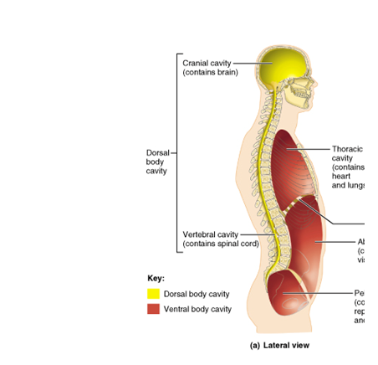

Slide 7
Ventral Cavity Subcompartments
thoracic cavity - The closed, partially membrane-lined sterile anatomical space, a subdivision of the ventral body cavity, which houses the lungs, heart, and the organs of the mediastinum;
pleural cavity - The two closed, membrane-lined sterile anatomical spaces, subdivisions of the ventral body cavity and of the thoracic cavity, which houses the right and left lungs respectively;

Slide 8
Ventral Cavity Subcompartments
pericardium cavity - The closed, membrane-lined sterile anatomical space, a subdivision of the ventral body cavity and of the thoracic cavity, which houses the heart;
mediastinum - The closed sterile anatomical space, not lined by a serous membrane, a subdivision of the ventral body cavity and of the thoracic cavity, which houses the heart in its pericardial sac, the great vessels, the trachea, the esophagus, and the thymus;

Slide 9
Ventral Cavity Subcompartments
abdominopelvic cavity - The closed, membrane-lined sterile anatomical space which houses various internal organs, particularly those of the digestive system;
abdominal cavity - The partially closed, membrane-lined sterile anatomical space which houses certain internal organs, the stomach, liver, intestines, and spleen;

Slide 10
Ventral Cavity Subcompartments
pelvic cavity - The partially closed, membrane-lined sterile anatomical space which houses some of the reproductive organs, the urinary bladder, and the distal colon;

